Slide 1
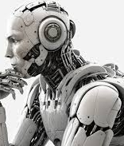
What I Learned in My Computer Vision Class Zaid Alayedy ITAI-1378
A Summary of Topics and Insights

Slide 2
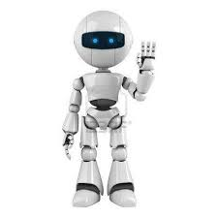
Introduction to Computer Vision
• Basics of Computer Vision
• Applications in real-world problems
• Importance of datasets and tools like GitHub and Google Colab
Useful References
https://docs.github.com/en/get-started
https://learngitbranching.js.org/

Slide 3
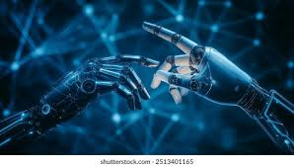
GitHub and Version Control
• Using GitHub for project collaboration
• Cloning repositories
• Managing code versions effectively
Useful References:
https://colab.research.google.com/notebooks/intro.ipynb
https://www.tensorflow.org/resources/colab

Slide 4
Google Colab for Development
• Cloud-based coding environment
• Running Python code efficiently
• Integration with machine learning libraries
Useful References:
https://docs.opencv.org/
https://scikit-image.org/docs/stable/

Slide 5
Image Processing Fundamentals
• Techniques for image preprocessing
• Resizing, normalization, and filtering
• Preparing images for model training
Useful References:
https://cs231n.github.io/convolutional-networks/
https://pytorch.org/tutorials/intermediate/torchvision_tutorial.html

Slide 6

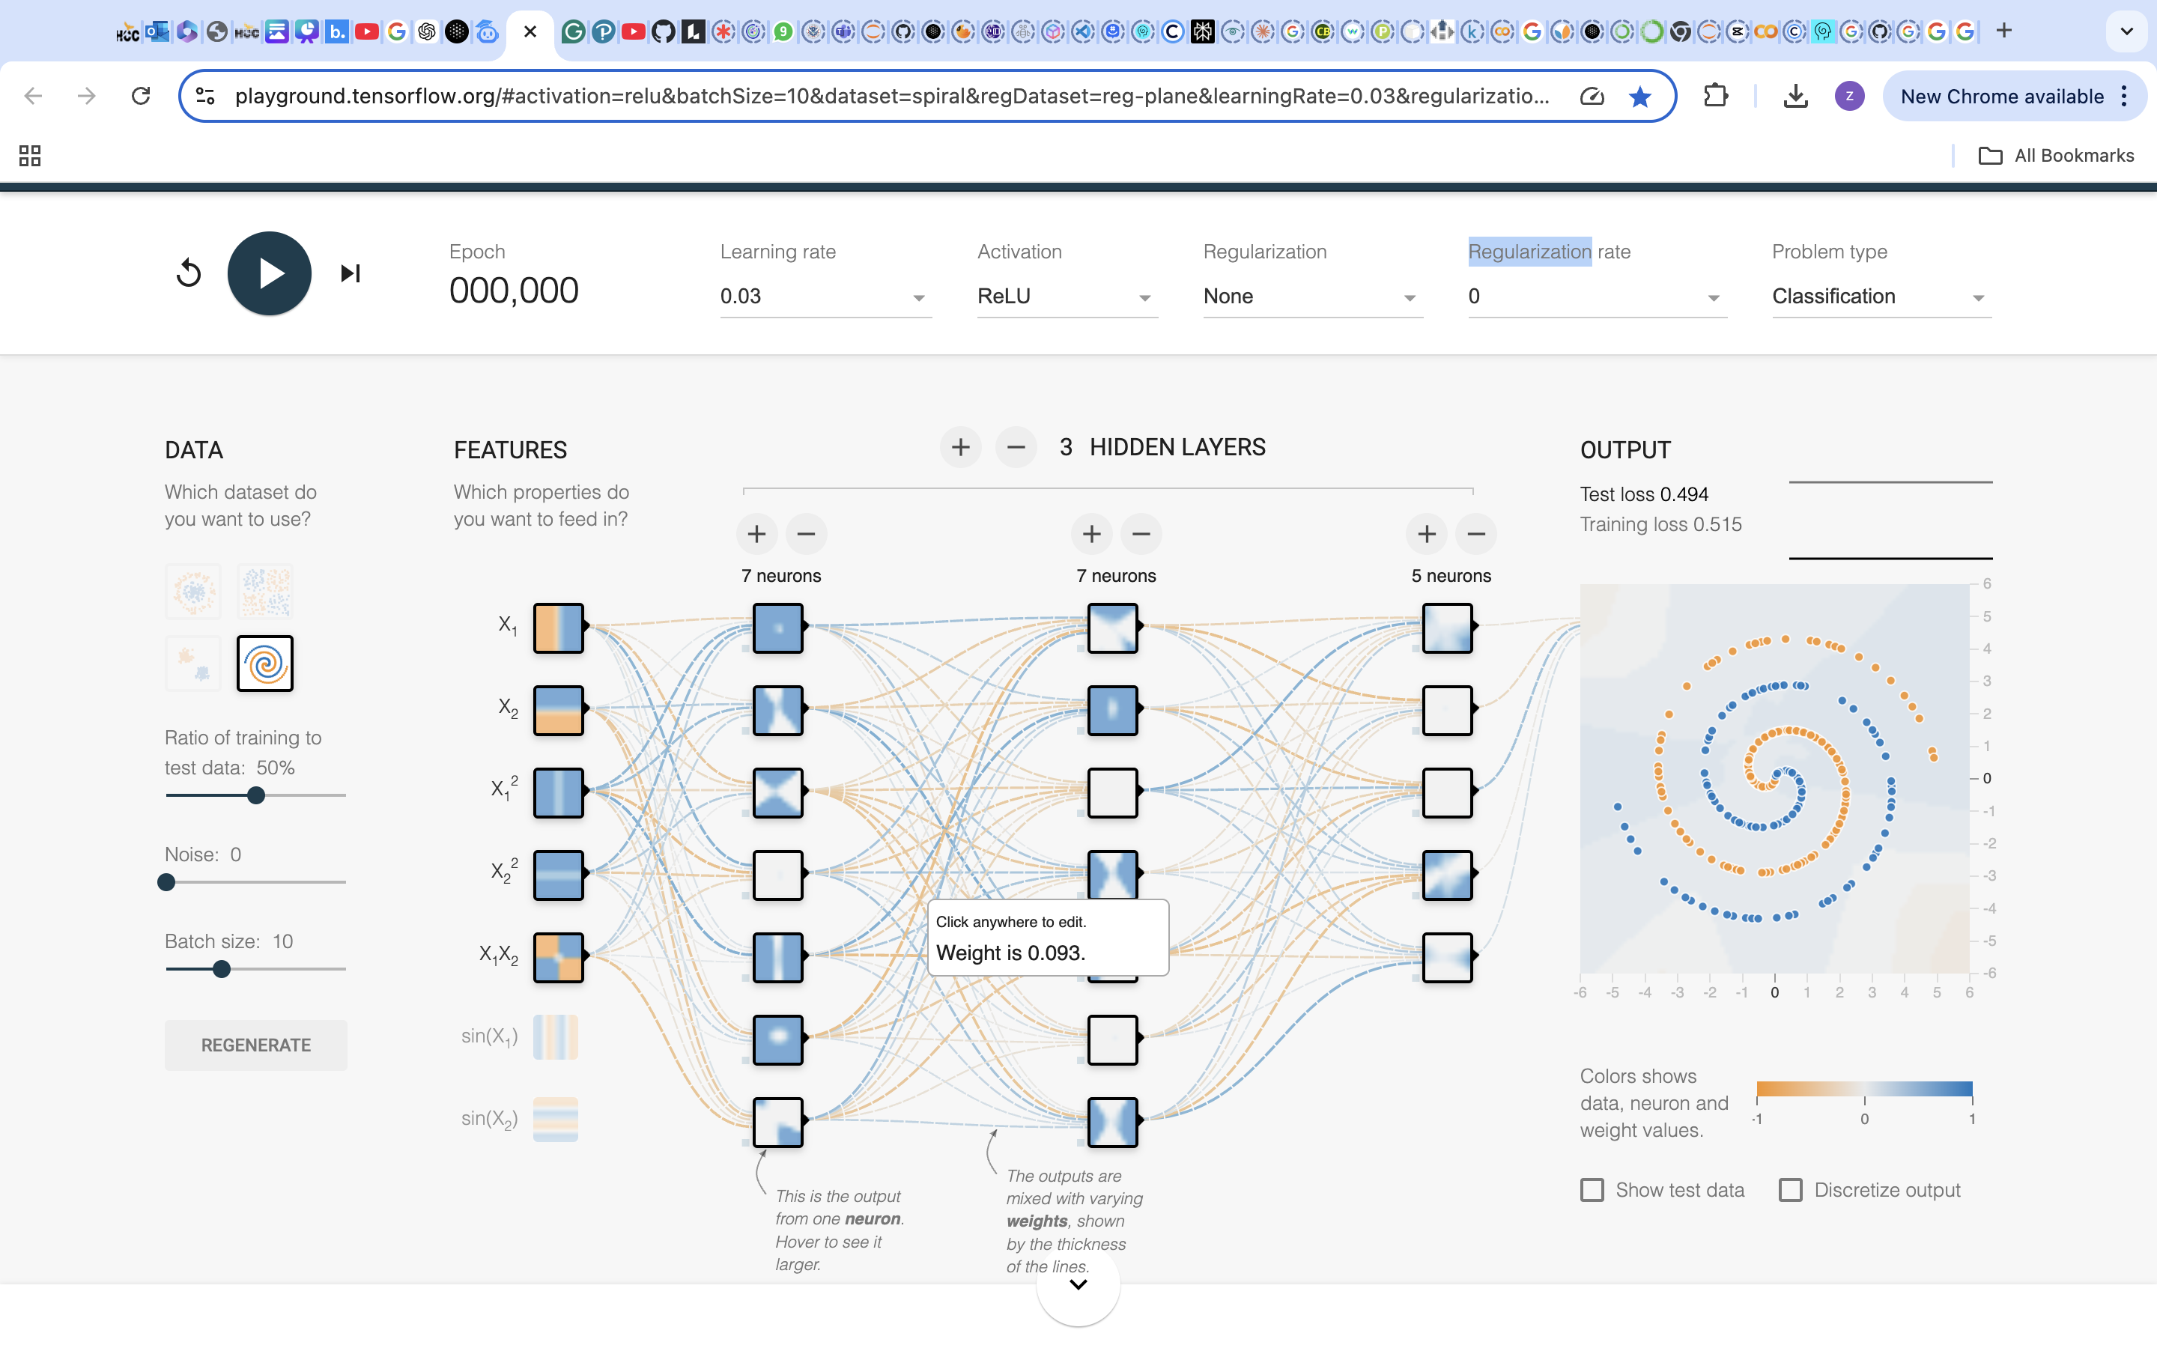
Neural Networks in Vision
• Understanding convolutional neural networks (CNNs)
• Applications in object detection and classification
• Practical exercises using PyTorch and TensorFlow

Slide 7
Data Augmentation Techniques
• Enhancing dataset diversity
• Rotation, flipping, and cropping
• Using augmentation to improve model accuracy
Useful References:
https://www.kaggle.com/datasets
https://archive.ics.uci.edu/ml/index.php

Slide 8
Projects and Assignments
• Hands-on projects using real-world datasets
• playing with a neural network for image classification
• Learning GitHub workflows through assignments
Useful References:
https://stackoverflow.com/
https://discuss.pytorch.org/

Slide 9
Challenges and Solutions
• Overcoming issues with dataset size
• Debugging model training errors
• Leveraging online resources and forums for solutions
Useful References:
https://towardsdatascience.com/
https://github.com/explore

Slide 10
Key Takeaways
• Importance of practical exercises
• Collaboration using tools like GitHub
• Exploring innovative applications of computer vision
Useful References:
https://ai.google/
https://www.mitre.org/research/technology-focus-areas/autonomy

Slide 11
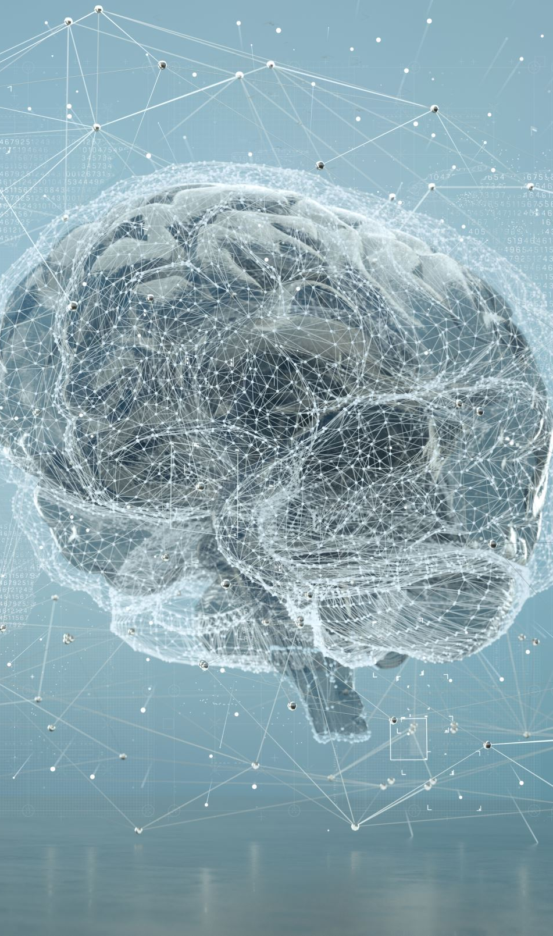
Future Applications
• Applying skills in AI and machine learning
• Exploring opportunities in autonomous systems
• Contribution to innovative real-world projects

